Slide 1
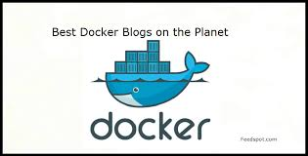
Docker
Docker is an open platform for developers and system administrators to build, ship and run distributed applications.
It enables developers and IT operations to build, secure and manage applications without technology or infrastructure lock-in.
Follow this blog to stay up to date on Docker news, updates and learn from experts to get the most out of Docker.

Slide 2
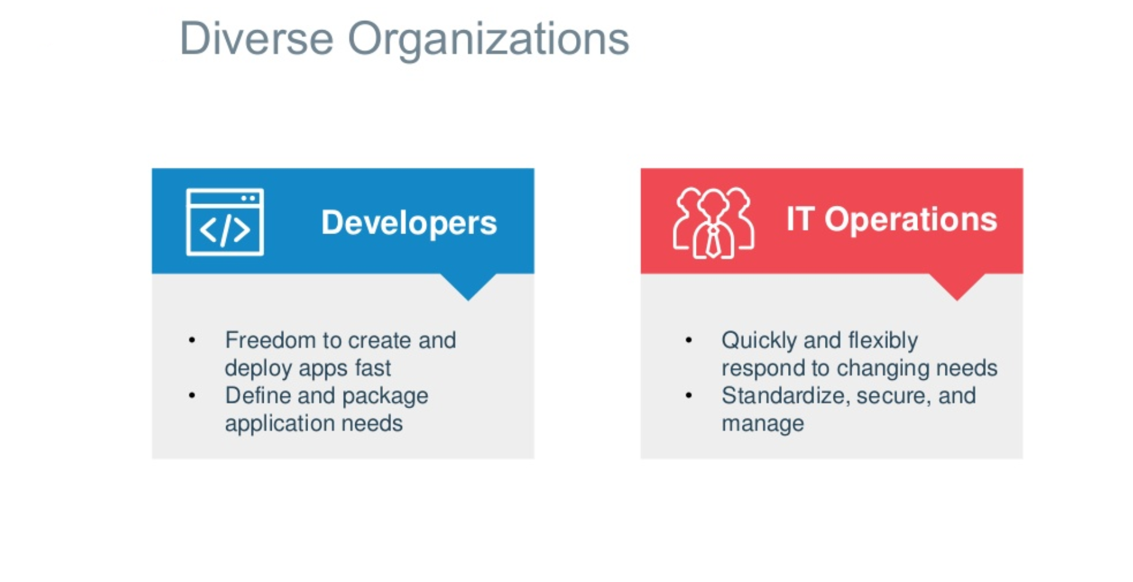

Slide 3
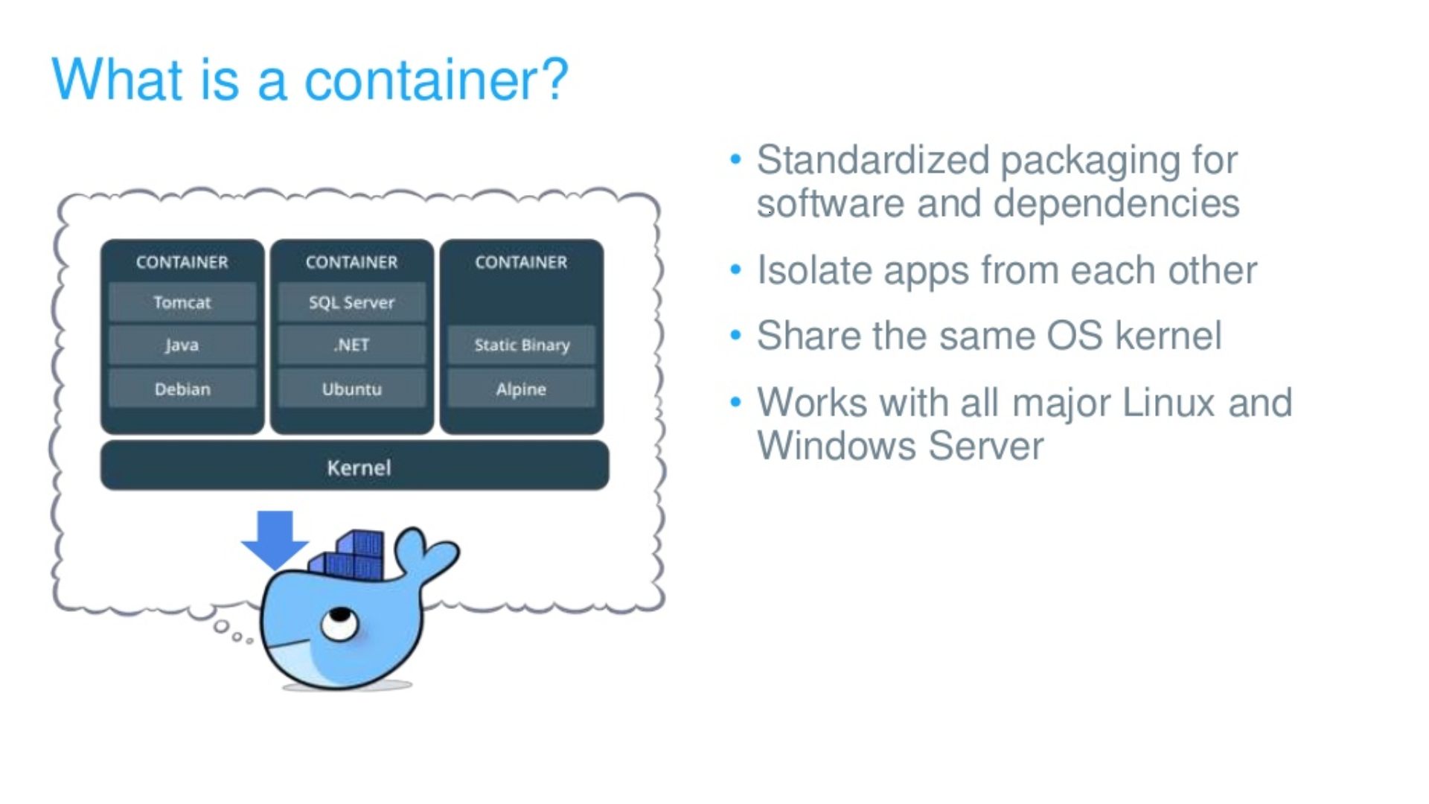

Slide 4
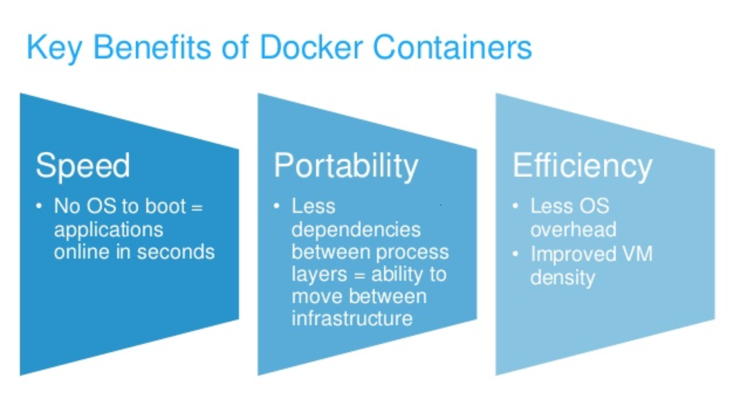

Slide 5
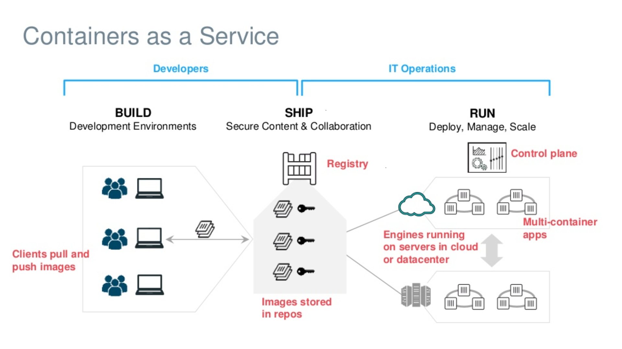

Slide 6
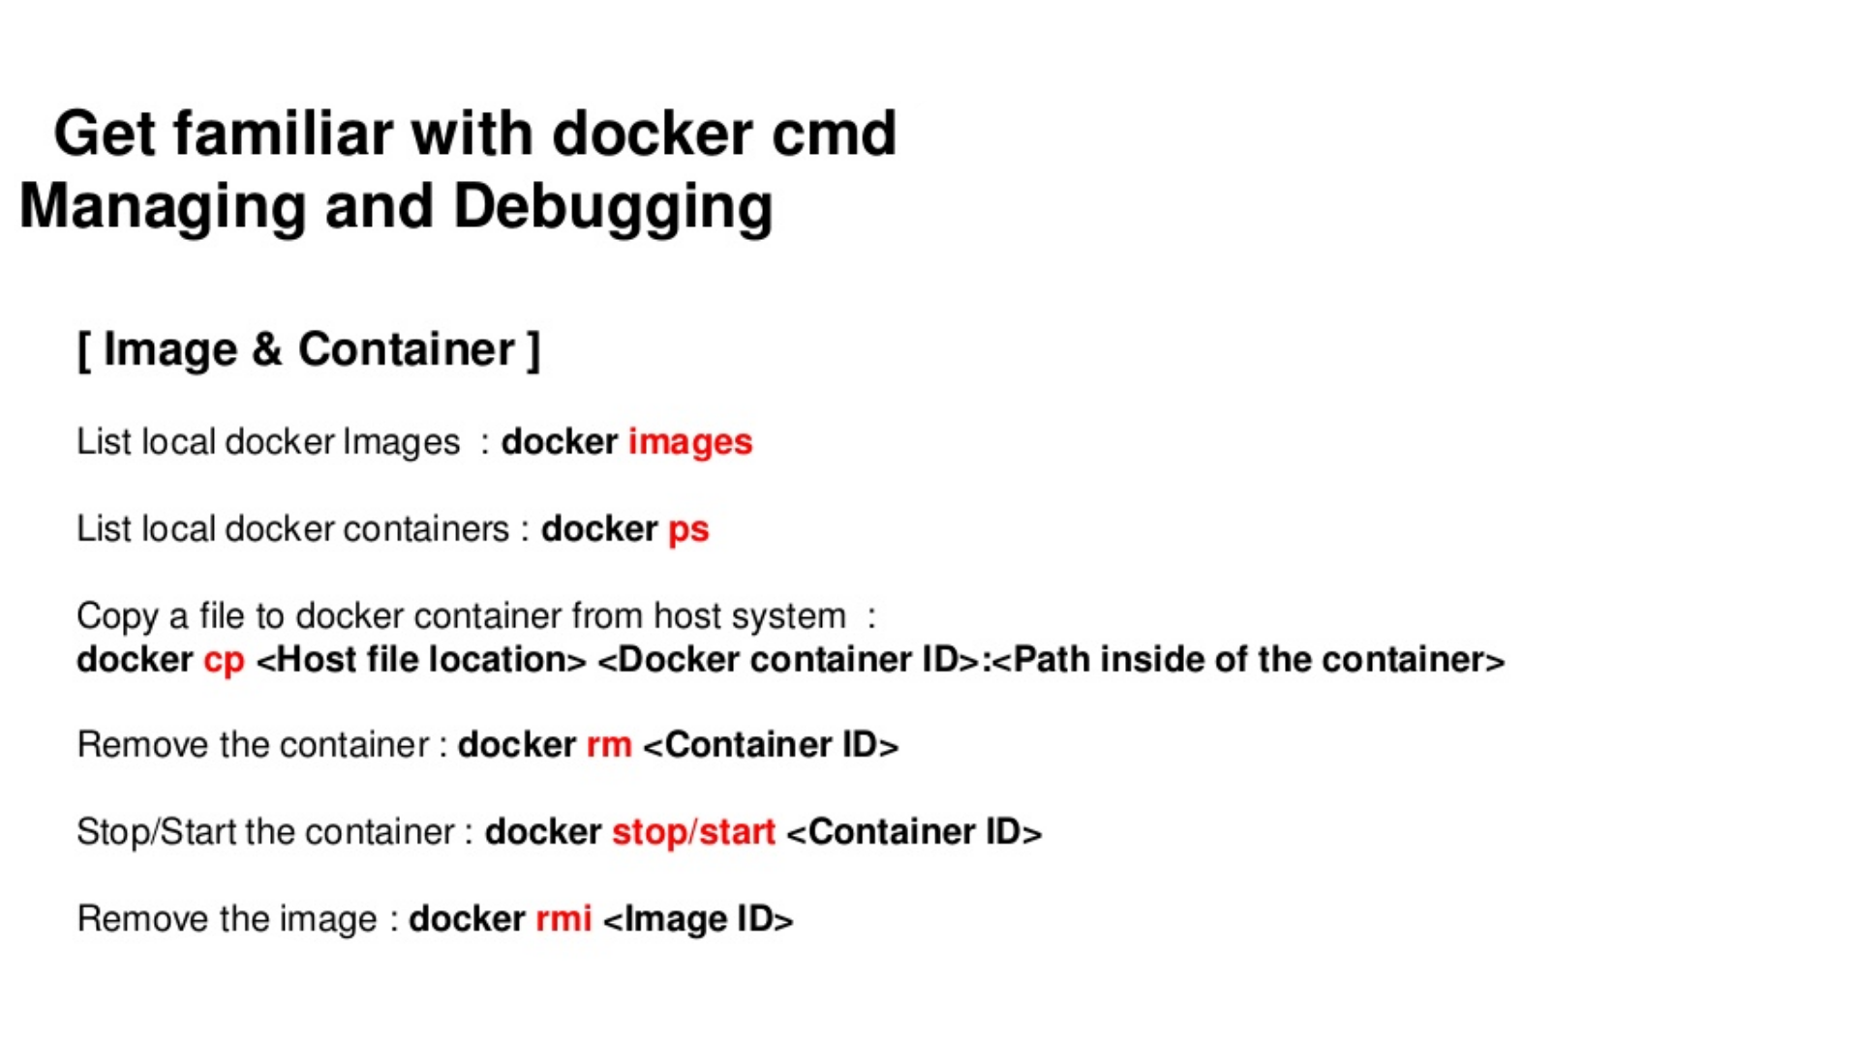

Slide 7
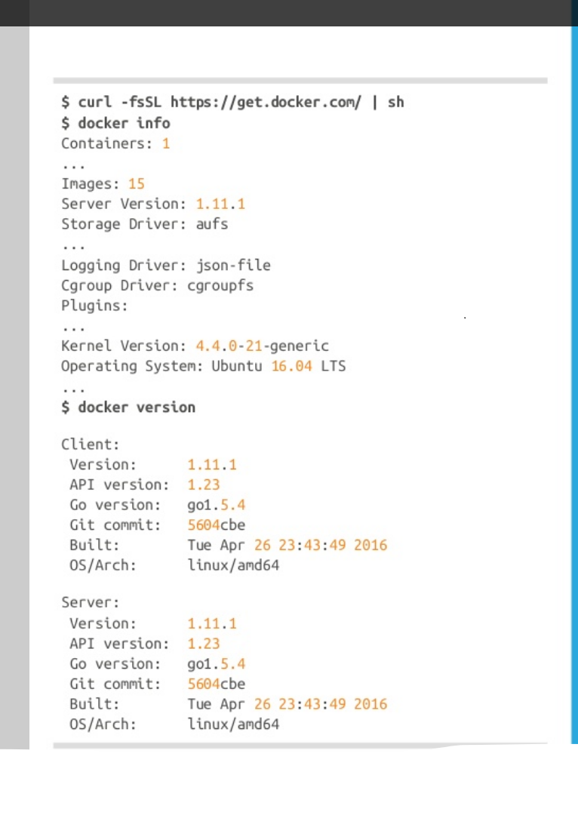

Slide 8
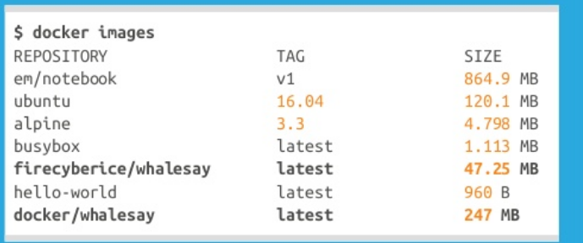

Slide 9
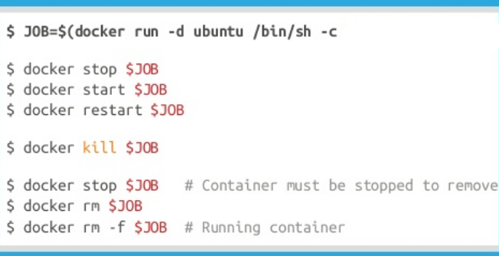

Slide 10
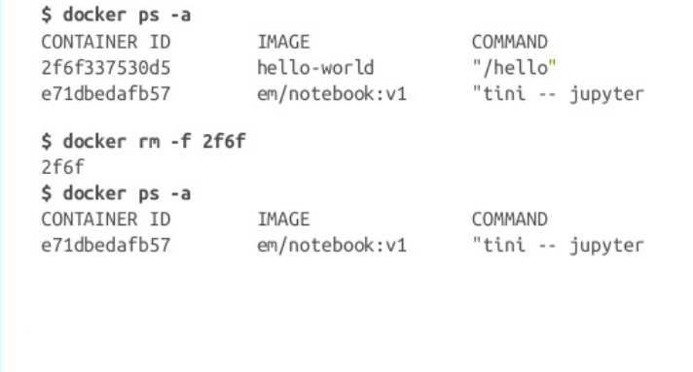

Slide 11
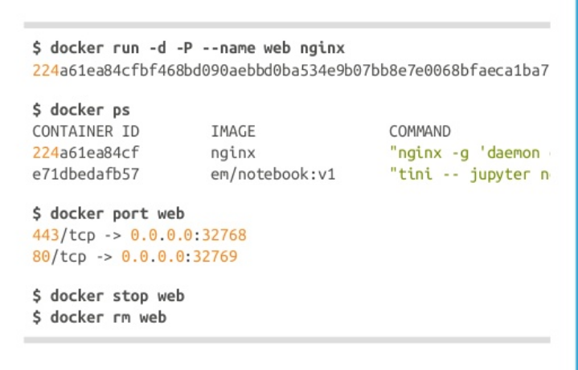

Slide 12
